Slide 1
Debugging
Lecturer: Ngo Huy Bien
Software Engineering Department
Faculty of Information Technology
VNUHCM - University of Science
Ho Chi Minh City, Vietnam
nhbien@fit.hcmus.edu.vn

Slide 2

Objectives
To debug errors

Slide 3

References
Steve McConnell (2004). Code Complete. Second Edition.

Slide 4



Debugging [1]
Debugging is the process of identifying the root cause of an error and correcting it.
Learn about the program you're working on.
Learn about how you find problems.
Learn about how you fix defects.
You’re human.
It’s your fault.
The best way to build a quality product is to develop requirements carefully, design well, and use high-quality coding practices.
Debugging is a last resort.

Slide 5

Bad Smells in Code
Problem: You don’t know where is the code that causes the bug.
Solution: Refactor your code.

Slide 6
Debugging Aids
Debugging aids code is the code that is used to quickly detect errors.
This may be logging code.
Don't automatically apply production constraints to the development version
and plan to remove debugging aids

Slide 7
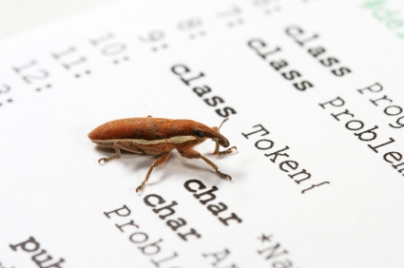
Defect Detection
Gather the data that produces the defect.
Analyze the data that has been gathered, and form a hypothesis about the defect.
Prove or disprove the hypothesis, either by testing the program or by examining the code.
Stabilize the error.
Unpredictable error detection:
Initialization error
Timing issue
Dangling-pointer problem

Slide 8

Hang/Crash Debugging
Problems:
Programs stop responding.
Programs consume 100 percent CPU.
Programs crash or shut down unexpectedly.
Possible causes:
Lock
Wait
Infinite loop

Slide 9


Fixing a Defect Practices
Understand the problem before you fix it.
Understand the program, not just the problem.
Save the original version.
Fix the problem, not the symptom.
Make one change at a time.
Perform regression test.

Slide 10

Thank You & See You Again

